Slide 1




NEXT GEN EMPLOYABILITY PROGRAM
Creating a future-ready workforce
Team Members
Paavai College of Engineering
Student Name : ABIRAME S
Student ID : 622021104001
Namakkal

Slide 2

CAPSTONE PROJECT SHOWCASE
Project Title
Building Bus Reservation System using Python and Django
Abstract | Problem Statement | Project Overview | Proposed Solution | Technology Used | Modelling & Results | Conclusion

Slide 3
Abstract
The bus reservation system serves as a critical component in the transportation industry, facilitating efficient travel arrangements for passengers.
This abstract outlines the key functionalities and features of a modernized bus reservation system aimed at enhancing the overall travel experience.
The proposed system incorporates advanced technologies to streamline the booking process, optimize resource utilization, and ensure passenger satisfaction.
Source :

Slide 4
Problem Statement
The current bus reservation systems in place suffer from various inefficiencies and shortcomings, leading to suboptimal user experiences, operational challenges, and revenue losses for service providers. This problem statement aims to identify and address these issues to create a more streamlined and customer-centric bus reservation system.
Complex Booking Process
Limited Accessibility
Inaccurate Scheduling and Tracking
Inefficient Resource Management
Limited Customization Options
Source :

Slide 5
Project Overview
Streamline the booking process: Develop an intuitive interface for users to search routes, check seat availability, and make reservations seamlessly.
Enhance accessibility: Implement features catering to passengers with disabilities or special needs to ensure inclusivity and compliance with regulatory standards.
Improve accuracy in scheduling and tracking: Integrate real-time tracking systems to provide accurate arrival/departure information, enhancing passenger trust and satisfaction.
Optimize resource management: Develop tools for effective allocation of vehicles and personnel to minimize operational costs and maximize asset utilization.
Source :

Slide 6
Proposed Solution
The proposed solution for the bus reservation system is a next-generation platform that revolutionizes the booking and management process for both passengers and bus operators. Leveraging cutting-edge technologies and user-centric design principles, the solution aims to enhance convenience, accessibility, and efficiency in bus travel.
User Interface
Authentication and Authorization
Bus and Route Management
Booking and Reservation
Ticket Management
.
Source :

Slide 7


Technology Used
Front-end
Back-end
Source :

Slide 8
Modelling & Results
To model a bus reservation system, we can consider the following entities and their attributes:
User:
Attributes: user_id, username, email, password, role (customer or administrator), etc.
Bus:
Attributes: bus_id, bus_name, bus_type, total_seats, etc.
Route:
Attributes: route_id, origin, destination, distance, etc.
Booking:
Attributes: booking_id, user_id (foreign key referencing User), bus_id (foreign key referencing Bus), route_id (foreign key referencing Route), booking_date, status (confirmed, canceled, pending), etc.
Seat:
Attributes: seat_id, bus_id (foreign key referencing Bus), seat_number, availability, etc.
Source :

Slide 9
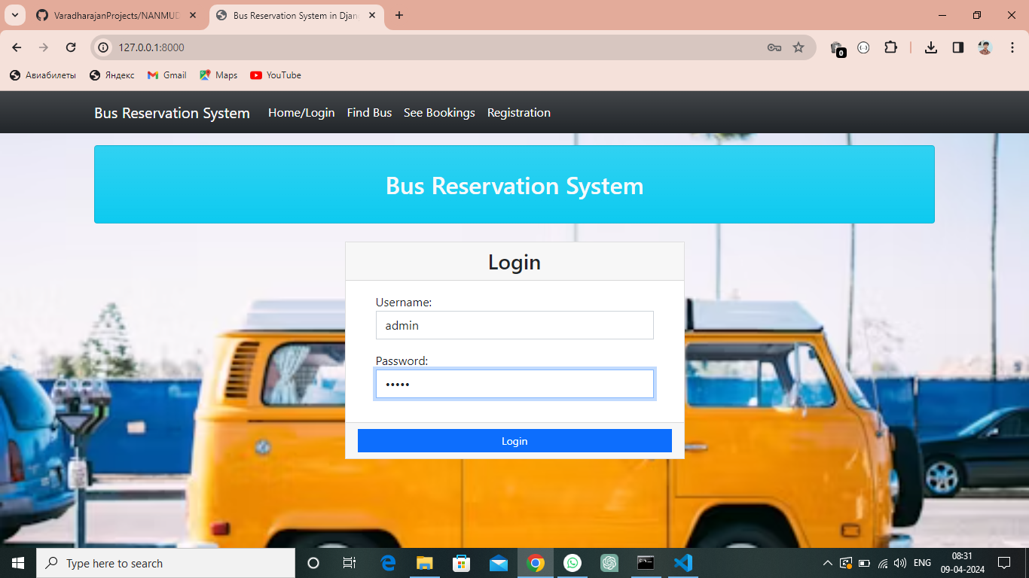
Homepage

Slide 10
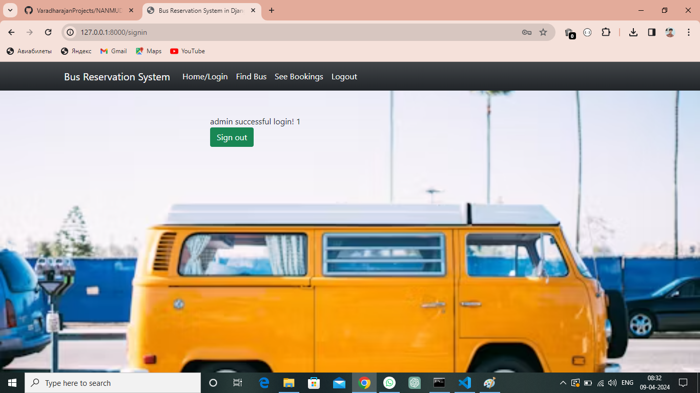
Login-Success-Page

Slide 11
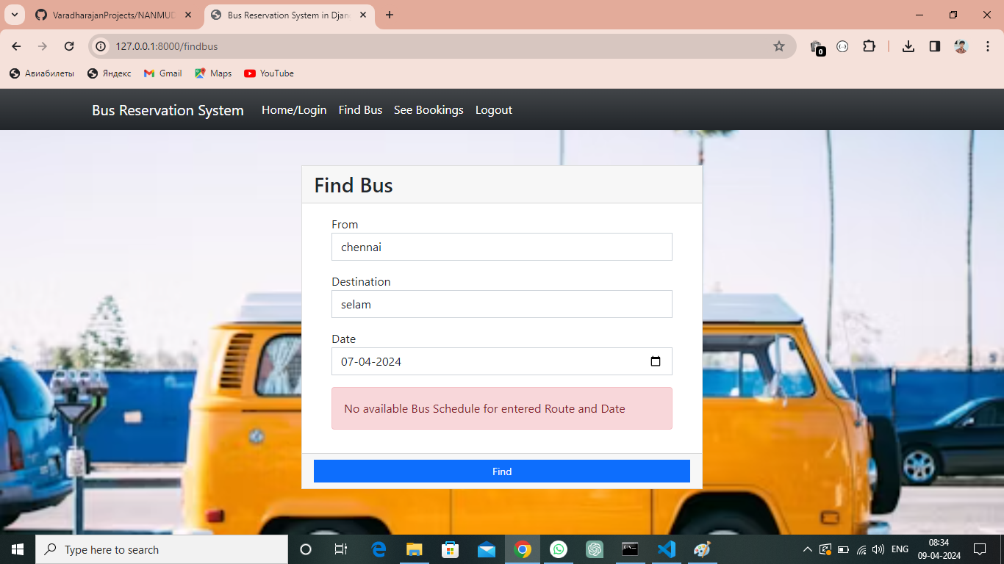
Find-Bus-Page

Slide 12
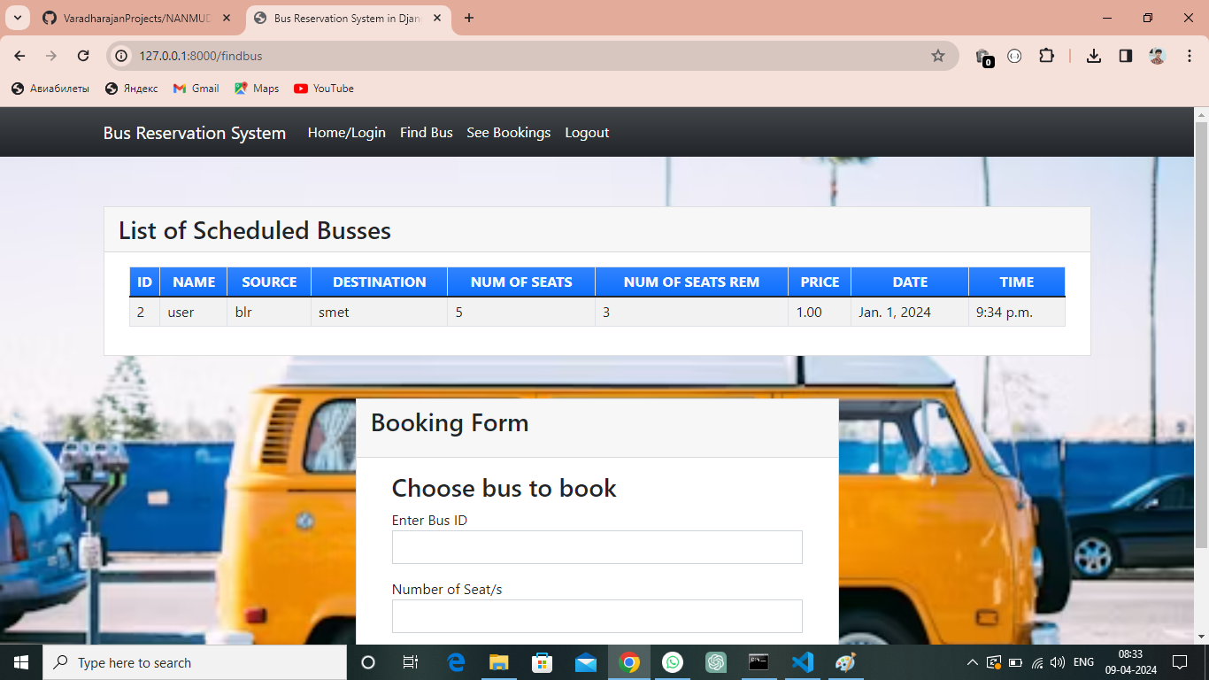
List of scheduled buses-Page

Slide 13
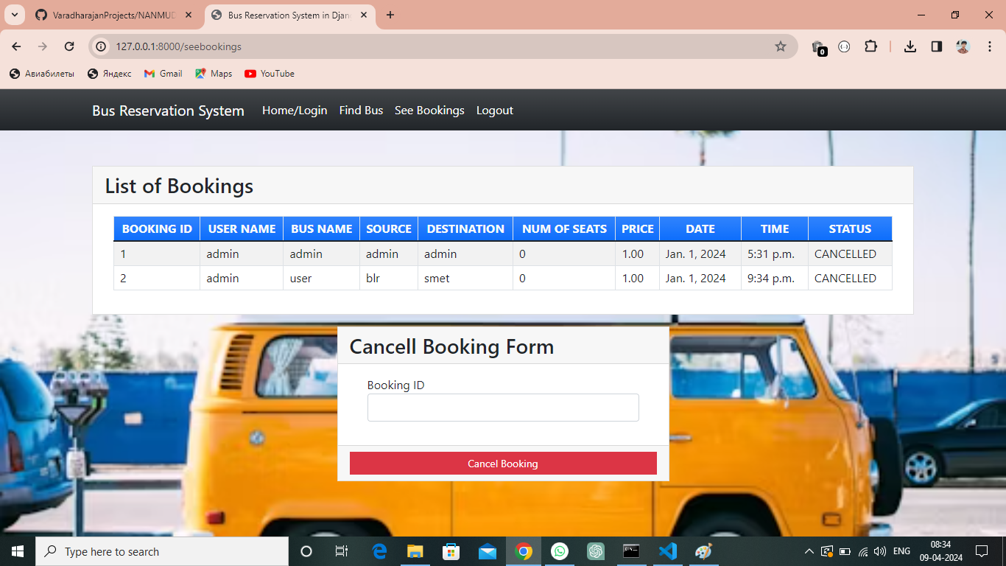
See-Booking-Page

Slide 14
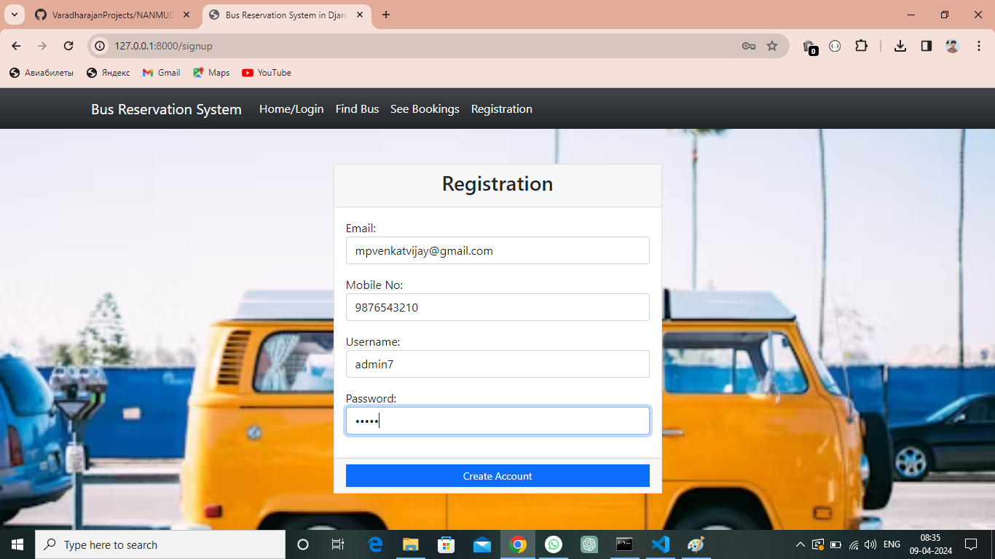
Register-Page

Slide 15
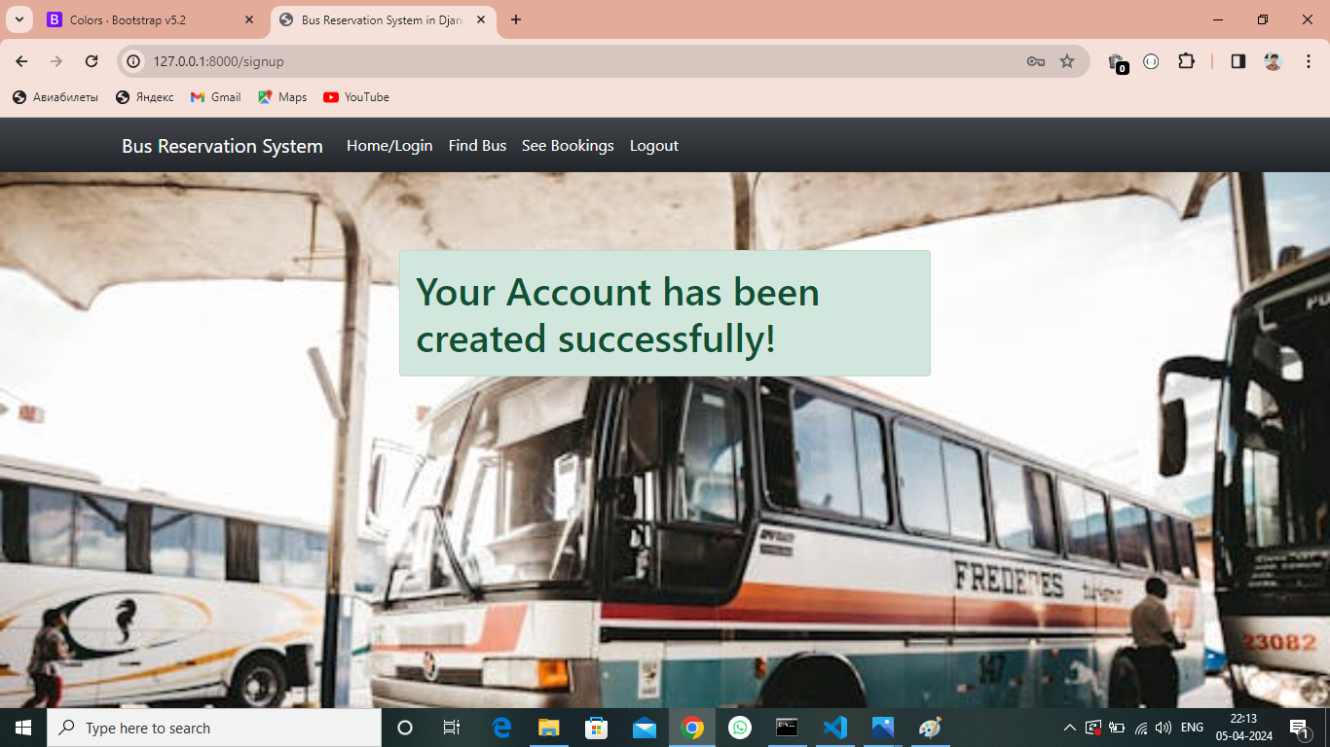
Register-Success-Page

Slide 16
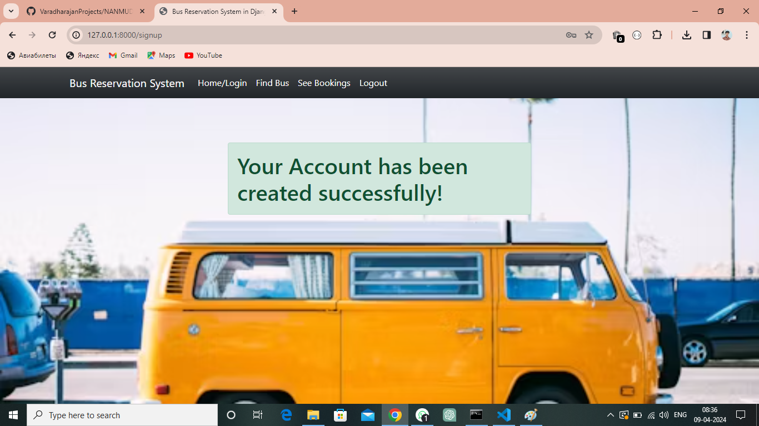
Register Success-Page

Slide 17
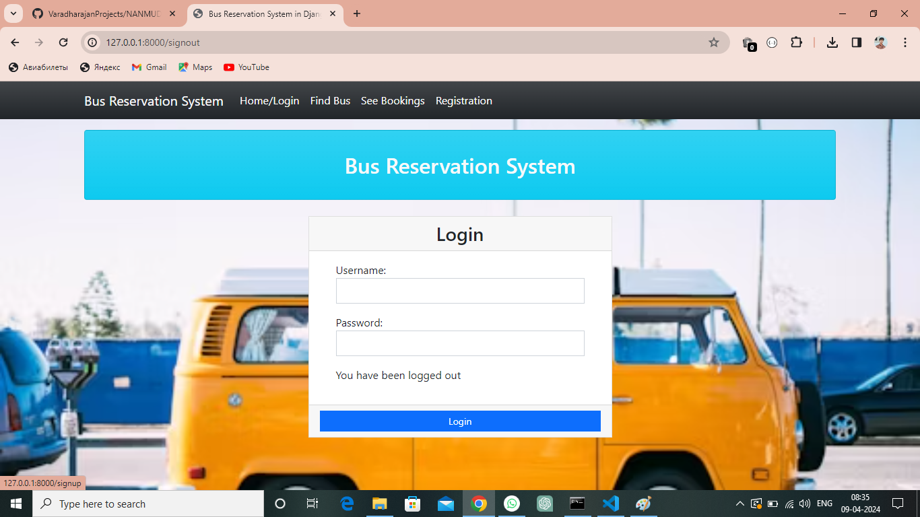
Logout-Page

Slide 18
Future Enhancements:
Mobile Application Development
Dynamic Pricing
Predictive Analytics
Integration with Travel Partners
Real-time Tracking and Alerts
Multi-language Support
Accessibility Features

Slide 19
Conclusion
In conclusion, a bus reservation system serves as a pivotal tool in facilitating efficient transportation services while enhancing the overall user experience. Through this system, passengers can seamlessly book tickets, select preferred seats, and manage their reservations, while administrators can effectively manage bus schedules, seat availability, and customer interactions.
The system's architecture, comprising user-friendly interfaces, robust authentication mechanisms, and secure payment gateways, ensures convenience and security for all stakeholders. Additionally, advanced features such as real-time tracking, dynamic pricing, and predictive analytics contribute to optimized operations, improved resource allocation, and enhanced customer satisfaction.
Source :

Slide 20
Thank You!
Notes:
Thank You !!

